Slide 1


A HUMAN’S PROJECT
Aim: Design a platform to track and improve sustainability
efforts on campus, such as energy consumption, waste management,
and carbon footprint reduction
CREATED BY:Shivraj,Sanjay Kumawat, Golu saini, Rohit kumawat

Slide 2

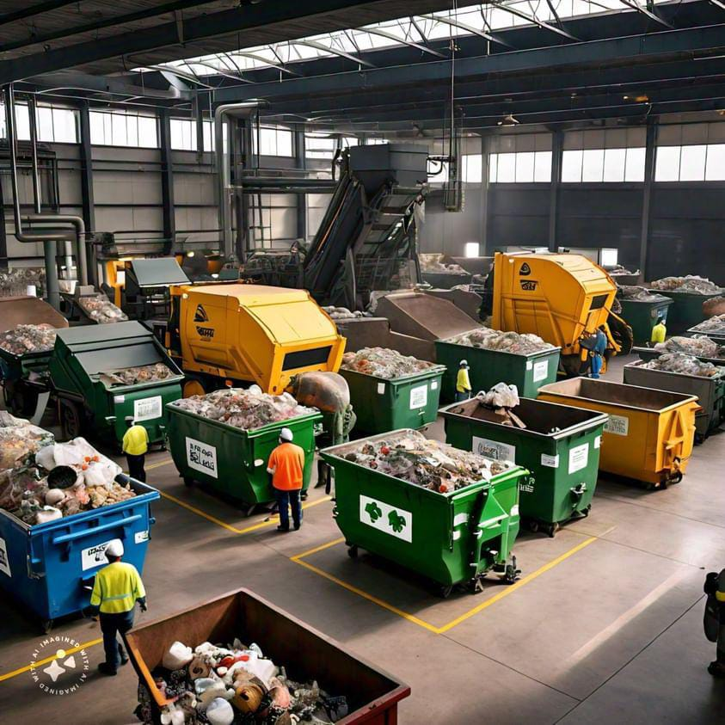

Improve sustainability efforts on campus
Energy consumption
Waste management
Carbon footprint reduction

Slide 3
Manage energy consumption
Saving electricity on a college campus can be a collective effort. Here are some tips:
*Turn off lights:* Encourage everyone to turn off lights when leaving rooms or areas not in use.
*Use natural light:* Make use of natural light during the day by keeping curtains open and utilizing daylight whenever possible.
*Energy-efficient appliances:* Install energy-efficient appliances in dorms and common areas to reduce electricity consumption.
*Unplug chargers:* Remind everyone to unplug chargers and electronic devices when not in use to avoid vampire power consumption.
*Energy-saving settings:* Set computers, printers, and other electronics to energy-saving settings or utilize power-saving modes.
*Educational campaigns:* Organize campaigns or workshops to raise awareness about the importance of saving electricity and how to do it effectively.
*Install motion sensors:* Install motion sensors in common areas and bathrooms to automatically turn off lights when not in use.
*Energy audits:* Conduct regular energy audits to identify areas where electricity is being wasted and implement solutions to address them.
*Switch to LED bulbs:* Replace traditional light bulbs with LED bulbs, which are more energy-efficient and have a longer lifespan.
*Encourage responsible usage:* Encourage students and staff to be mindful of their electricity usage and to adopt energy-saving habits in their daily routines.

Slide 4
Waste management
There are several things you can do for waste management in college:
*Reduce*: Encourage the use of reusable items like water bottles, coffee mugs, and containers to minimize single-use plastics.
*Reuse*: Set up donation stations for items that are still in good condition but no longer needed, like clothes, books, and electronics.
*Recycle*: Provide clearly labeled recycling bins around campus for paper, plastics, glass, and metals.
4. *Compost*: Implement composting programs for food waste in dining halls and other campus facilities.
5. *Educate*: Offer workshops, seminars, or informational campaigns to raise awareness about waste management practices and their importance.
6. *Collaborate*: Partner with local recycling facilities or waste management companies to ensure proper disposal and recycling of waste.
7. *Incentivize*: Create rewards or recognition programs for individuals or departments that excel in waste reduction efforts.

Slide 5
Carbon Footprint, Reduction
Reducing the carbon footprint of your college involves various strategies:
*Energy Efficiency*: Implement energy-efficient measures such as LED lighting, smart thermostats, and energy-efficient appliances across campus buildings.
2. *Renewable Energy*: Invest in renewable energy sources like solar panels or wind turbines to power campus facilities.
3. *Transportation*: Encourage the use of public transportation, biking, or walking by providing bike racks, promoting carpooling, and offering incentives for using eco-friendly transportation methods.
4. *Sustainable Practices*: Adopt sustainable practices in food services, procurement, and landscaping, such as sourcing locally grown produce, using eco-friendly products, and implementing water conservation measures.
5. *Waste Reduction*: As mentioned earlier, focus on waste reduction, recycling, and composting to minimize the environmental impact of waste disposal.
6. *Education and Awareness*: Organize workshops, seminars, or courses on climate change, sustainability, and environmental conservation to raise awareness and promote sustainable behaviors among students, faculty, and staff.
7. *Partnerships*: Collaborate with local organizations, businesses, and government agencies to exchange ideas, resources, and best practices for reducing carbon emissions and promoting sustainability.
8. *Carbon Offsetting*: Consider investing in carbon offset projects to compensate for unavoidable emissions, such as tree planting initiatives or renewable energy projects in communities.
9. *Monitoring and Reporting*: Regularly monitor and track carbon emissions from campus activities, set reduction targets, and report progress to stakeholders to foster accountability and continuous improvement.

Slide 6

THANK YOU
CREATED BY:Shivraj,Sanjay Kumawat, Golu saini, Rohit kumawat

